Slide 1
General announcements

Slide 2
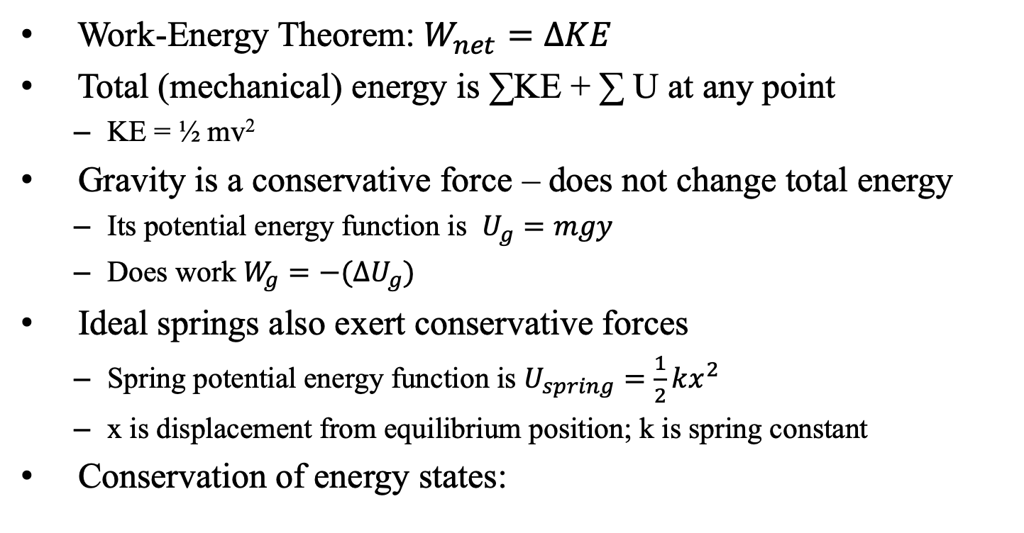
Things we know so far
Work-Energy Theorem: $W_{net}=ΔKE$
Total (mechanical) energy is ∑KE + ∑ U at any point
KE = ½ mv²
Gravity is a conservative force – does not change total energy
Its potential energy function is $U_{g}=mgy$
Does work $W_{g}=−(ΔU_{g})$
Ideal springs also exert conservative forces
Spring potential energy function is $U_{spring}=\frac{1}{2}kx^{2}$
x is displacement from equilibrium position; k is spring constant
Conservation of energy states:

Slide 3
F-d graphs
Given a graph of force vs displacement, how could you calculate the work done?
On an Fd graph, the work done in any segment is the area under the graph. To get net work, add up each segment!
What happens if the graph dips into –F territory? (-work is done)

Slide 4
Fd graph
Given the force vs displacement graph below, determine:
(a) the work done for each segment of the graph (AB, BC, CD, DE)
(b) the net work done
(c) if the object has a mass of 1 kg and v = 1 m/s at x = 0, how fast is it moving at point C?
F (N)
6
4
2
A
B
x (m)
5 10 15 20 25
-2
-4
-6
C
D

